Slide 1


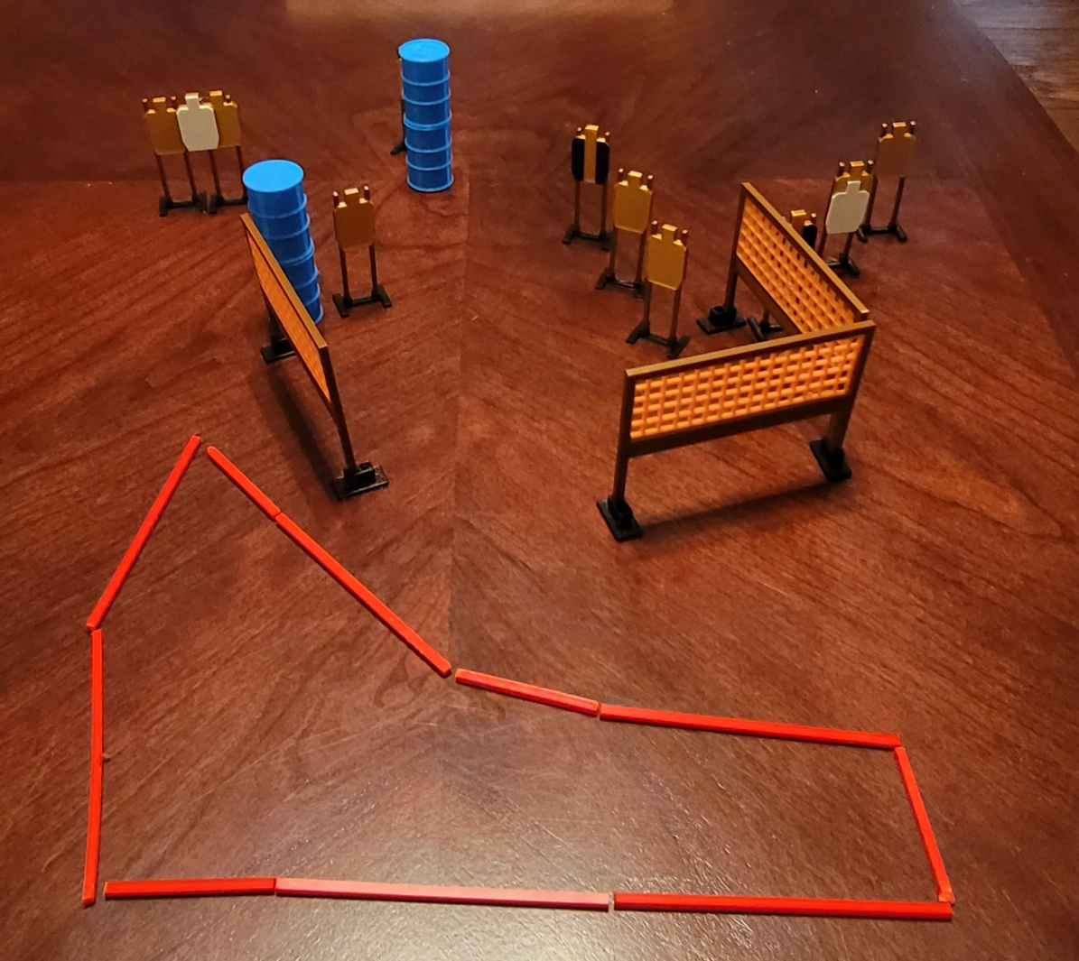
 | Dothan Gun Club – USPSA Match Middle Money Course Designer : Eric Henwood Bay: B1
Round Count 20 rounds 10 USPSA
Equipment List 5 wall feet 2 tux 10 targets (8 + 2 NS)

Slide 2
Middle Money
Written Stage Briefing
Scoring: Comstock Rounds: 20
Targets: 10 USPSA
Handgun start position: anywhere inside the shooting area, wrists below belt. Handgun is loaded and holstered.
PCC start position: anywhere inside the shooting area, stock on belt. Loaded carbine is held with both hands, safety on.
Stage Procedure: on the audible start signal, engage targets as they become available from within the shooting area. The last three targets must only be engaged strong hand only.

